Slide 1
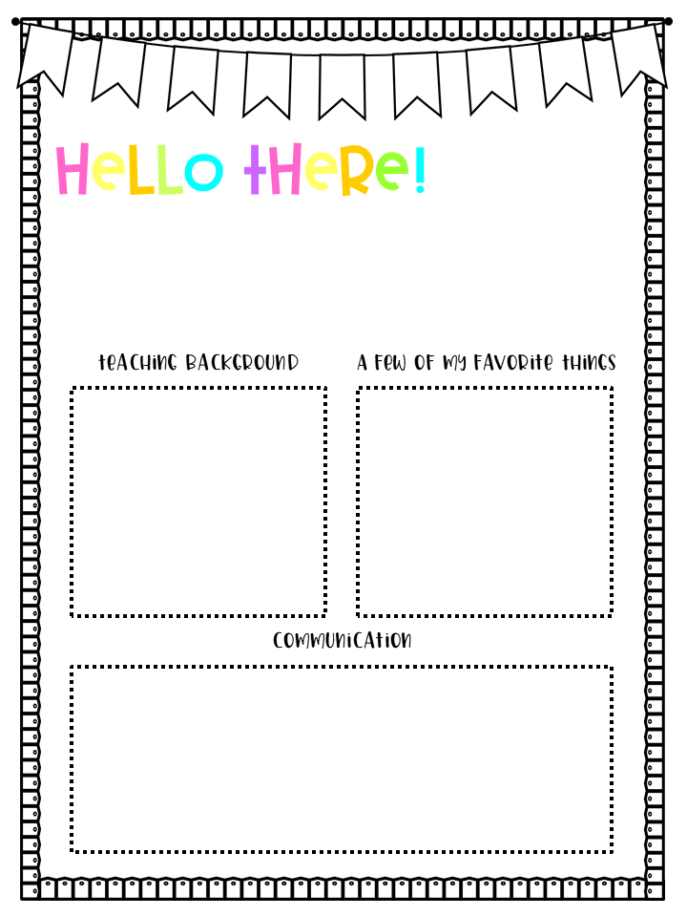
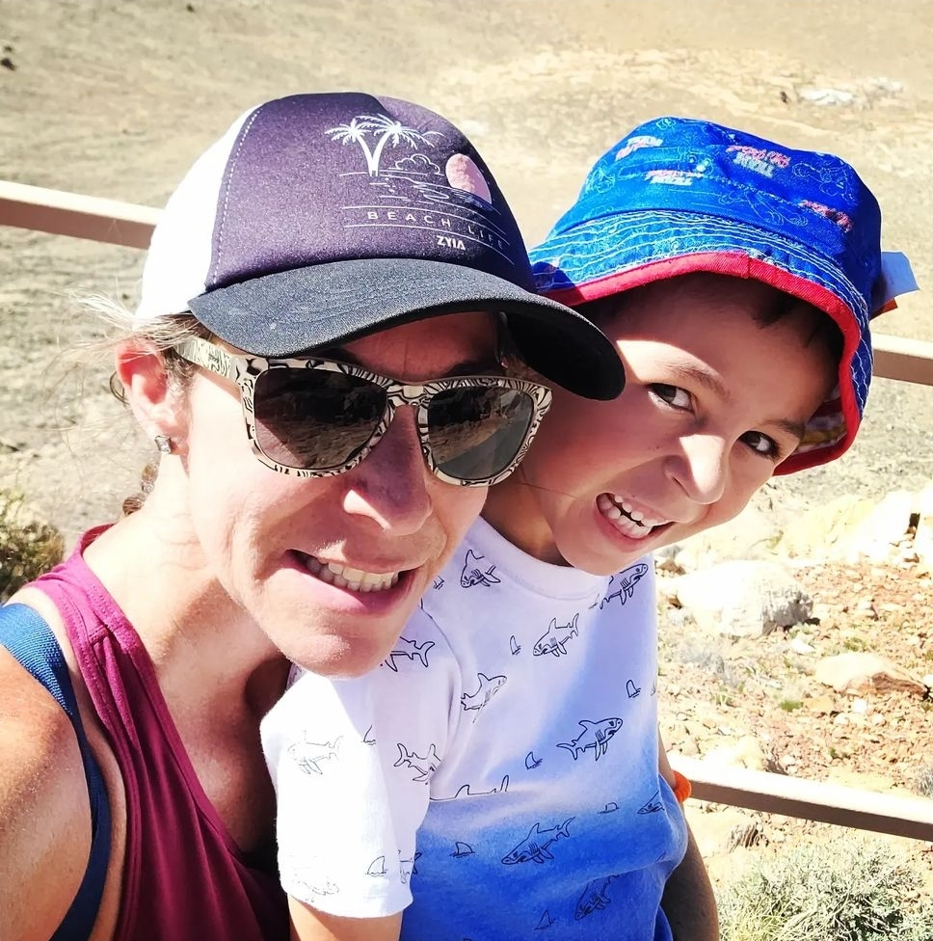
INSERT
PICTURE
HERE
My name is Sarah Mezo
and I am EXCITED to be your child’s second grade teacher for the 2022-2023 school year here at Bologna Elementary!
This year I will be going into my 19th year of teaching, with 18 of those taking place here at Bologna!
I graduated from Eastern Oregon University where I majored in Elementary Education. I have my Early Childhood & Structured English Immersion Endorsements. I’m looking forward to working with you all to make this year an amazing learning experience for every student.
Colors: purple, red, green
Foods: pizza, chicken wings, Sour Cream & Onion Chips
Drinks: Monster Zero and
iced coffee with caramel & vanilla
Favorite children's book: Have You Filled a Bucket Today?
Hobbies: running, hiking, paddle boarding, traveling & spending time with my son, Connor.
Restaurant: Copper Still & Salad N Go
Stores: Target, Walmart
Email: mezo.sarah@cusd80.com
Phone Number: (480) 883-4044
You can also communicate with me through ClassDojo and your child’s Homework Folder.
If you have any questions, concerns, or want to inform me of anything you would like me to know about your student, please do not hesitate to contact me. Thank you so much and I am really looking forward to getting to know you and your student!

